Slide 1

Project Title -
Seasonal Agriculture Performance Analysis
Student Name -
SHOAIB S W
College Name -
East Point College of Engineering and Technology
Bengaluru , Karnataka
AICTE Student ID :
STU68fa545b391751761236059

Slide 2

PROBLEM STATEMENT
Agricultural activities are influenced by seasonal variations in environmental conditions, farming practices, resource availability, and market conditions, resulting in differences in agricultural performance across seasons. However, raw agricultural data does not clearly explain these seasonal variations or the patterns observed under different conditions. Therefore, this project analyses the given agricultural dataset to identify meaningful patterns, trends, relationships, and variations in agricultural performance across different seasons.

Slide 3
Project Description
Analyzed a 4,000-record agricultural dataset with 28 attributes.
Performed data cleaning and data preparation.
Conducted Exploratory Data Analysis (EDA) to understand the dataset.
Analyzed agricultural performance across seasons and crops.
Studied environmental factors such as rainfall, temperature, humidity, soil pH, and soil moisture.
Analyzed production, revenue, and profit to understand economic performance.
Studied water, fertilizer, and pesticide usage.
Performed state and district-wise geographical analysis.
Used NumPy for statistical analysis and correlation analysis.
Performed relationship and comparative analysis using visualizations.
Identified key findings and provided data-driven recommendations for agricultural planning.

Slide 4

WHO ARE THE END USERS?
Farmers – To support crop selection, seasonal planning, and resource management.
Agricultural Planners – To compare seasonal and regional agricultural performance.
Government & Agricultural Departments – To support data-driven agricultural planning and decision-making.
Agricultural Researchers – To study relationships between environmental conditions, resources, and crop performance.
Agribusiness & Farming Organizations – To understand production, revenue, profit, and resource usage patterns.
Data Analysts & Students – To analyze agricultural data and derive meaningful insights.

Slide 5

Technology Used
Python – Main programming language for data analysis.
Pandas – Data loading, cleaning, preparation, and analysis.
NumPy – Statistical calculations and numerical analysis.
Matplotlib – Data visualization and charts.
Google Colab – Development and execution environment.
CSV Dataset – Source format of the agricultural dataset.
Data Analysis Techniques – EDA, correlation analysis, relationship analysis, and comparative analysis.

Slide 6
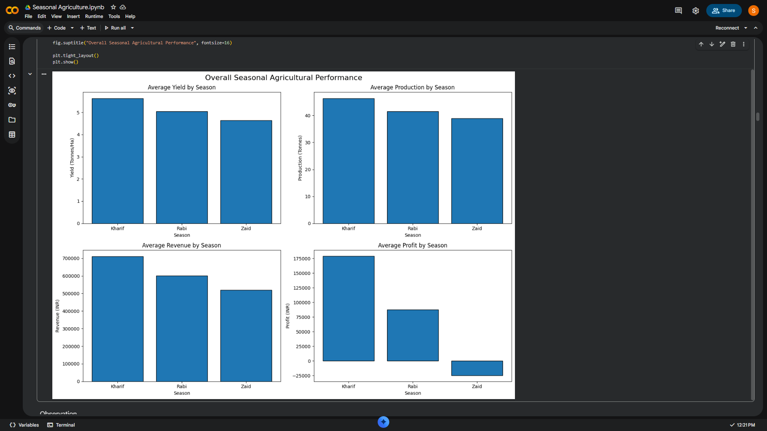
RESULTS

Slide 7
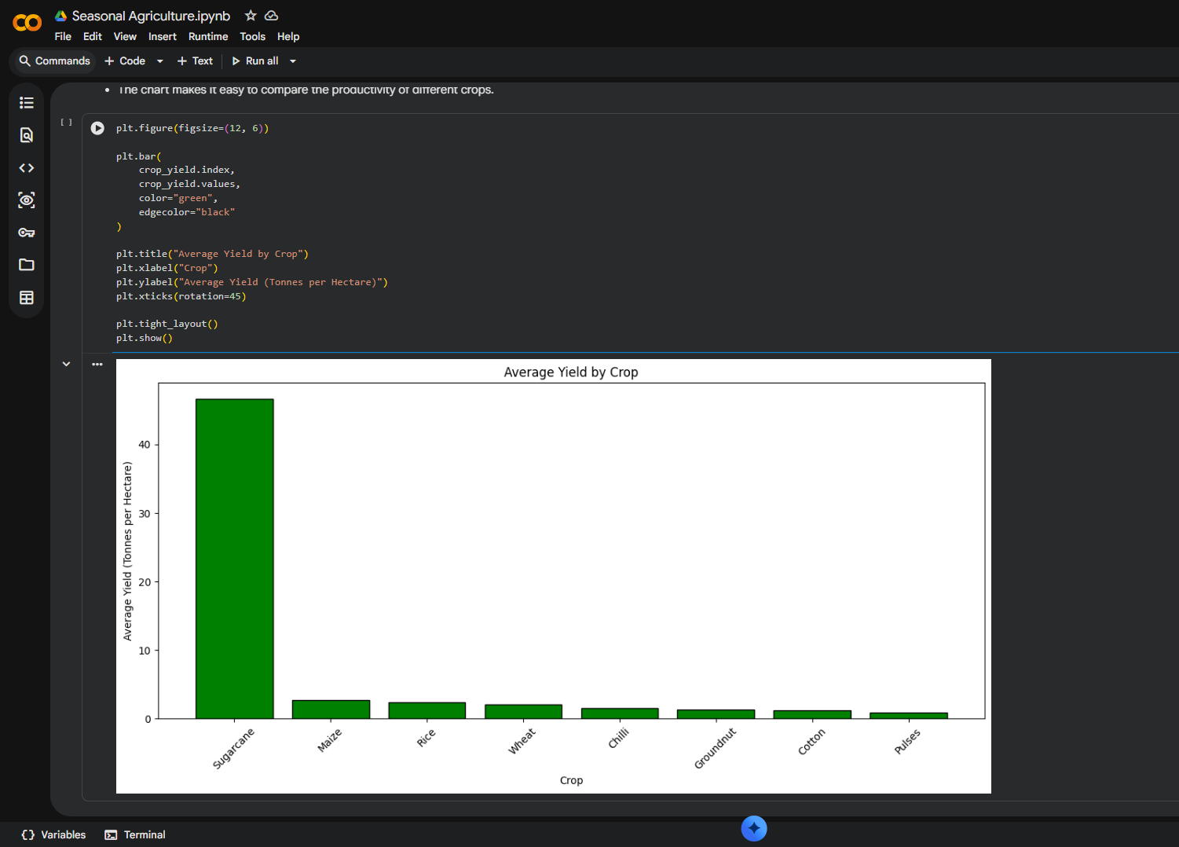
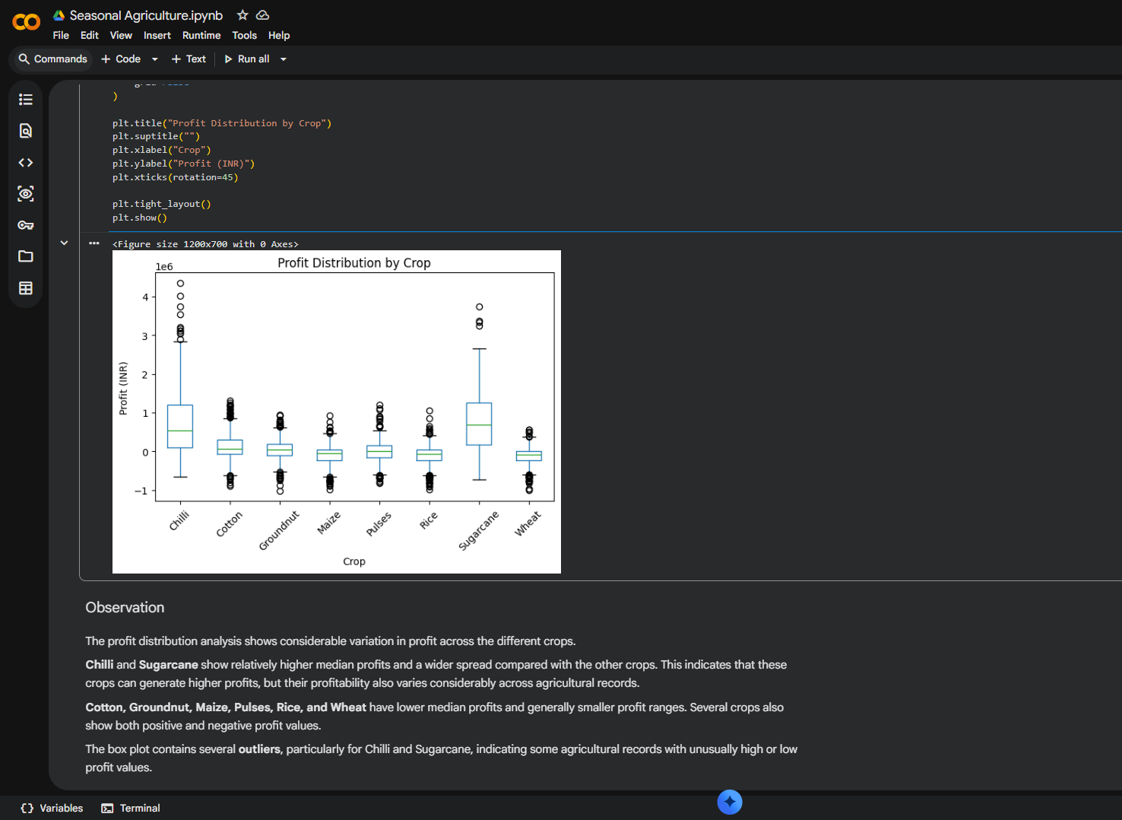
RESULTS

Slide 8
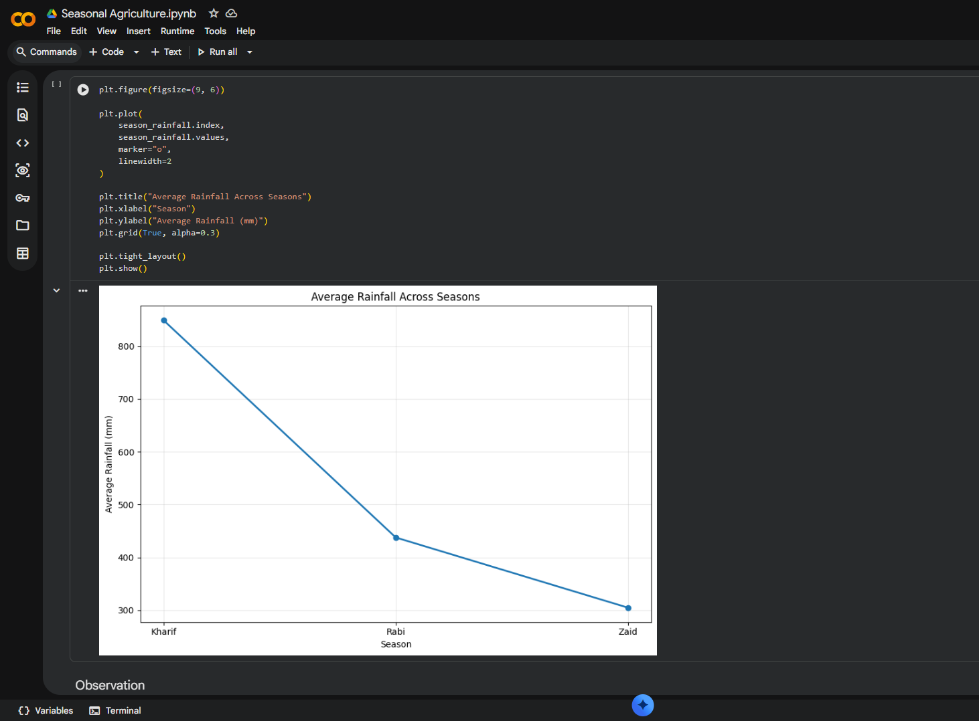
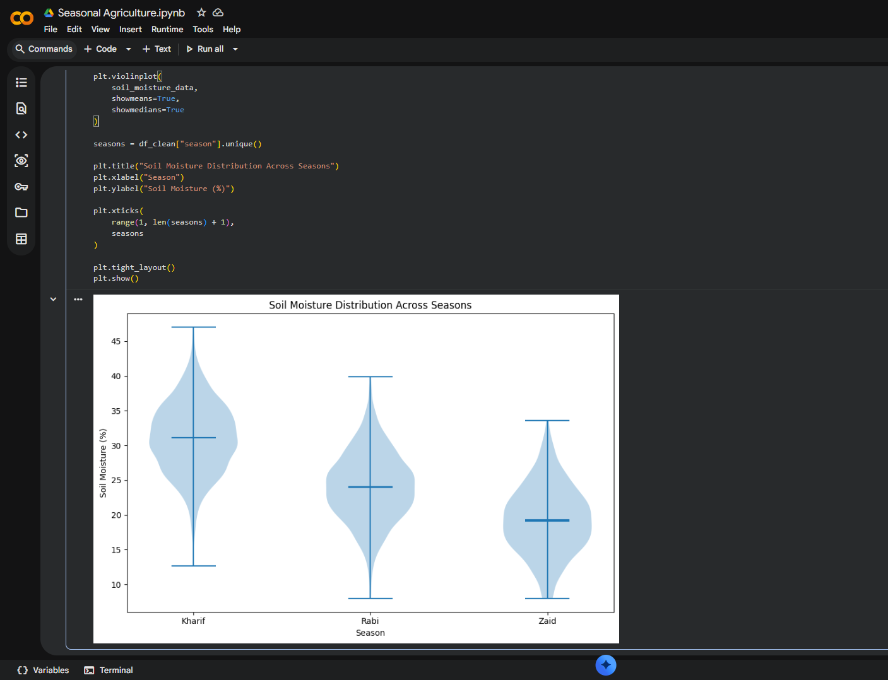
RESULTS

Slide 9
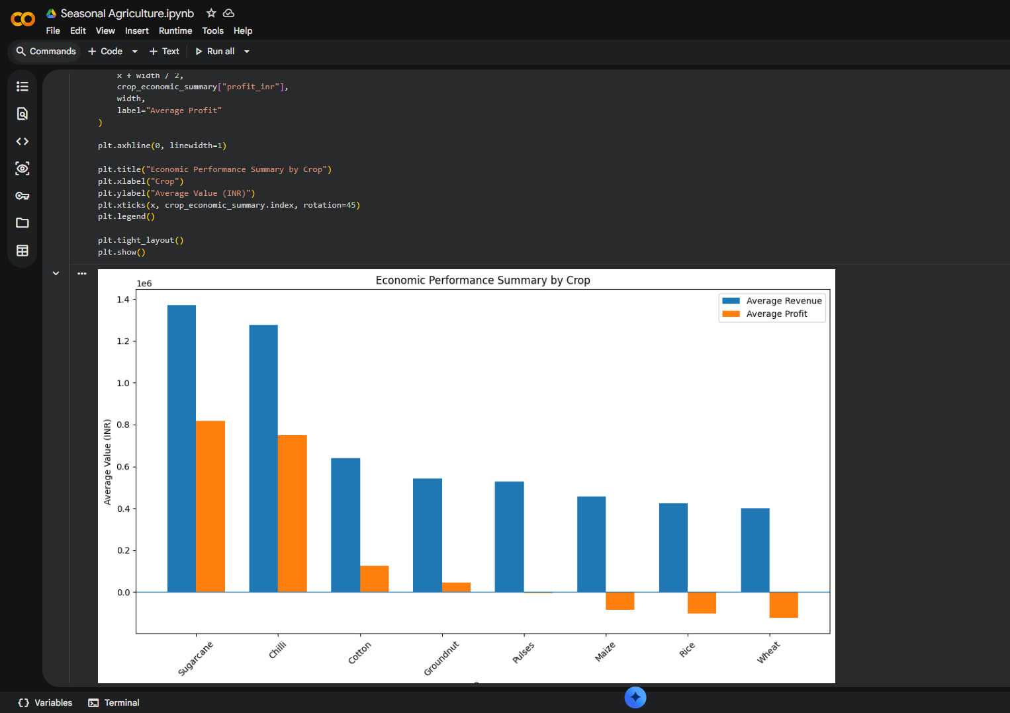
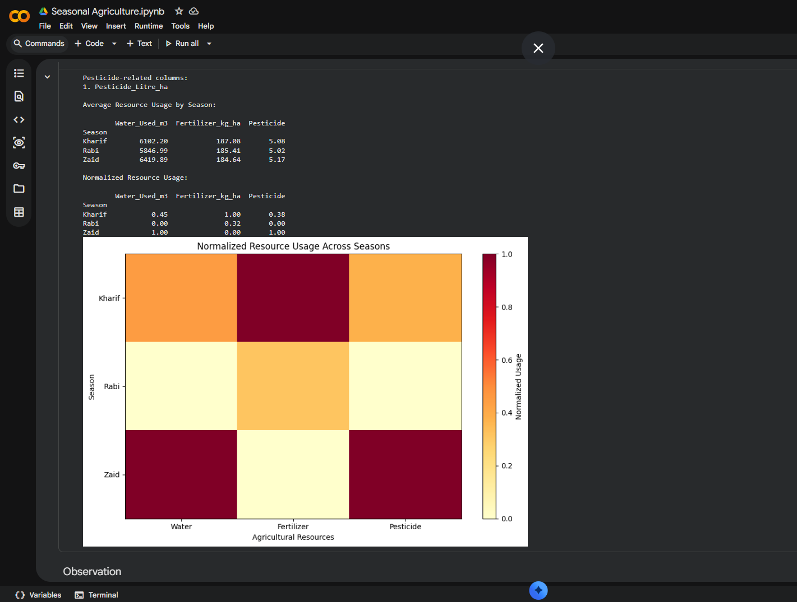
RESULTS

Slide 10
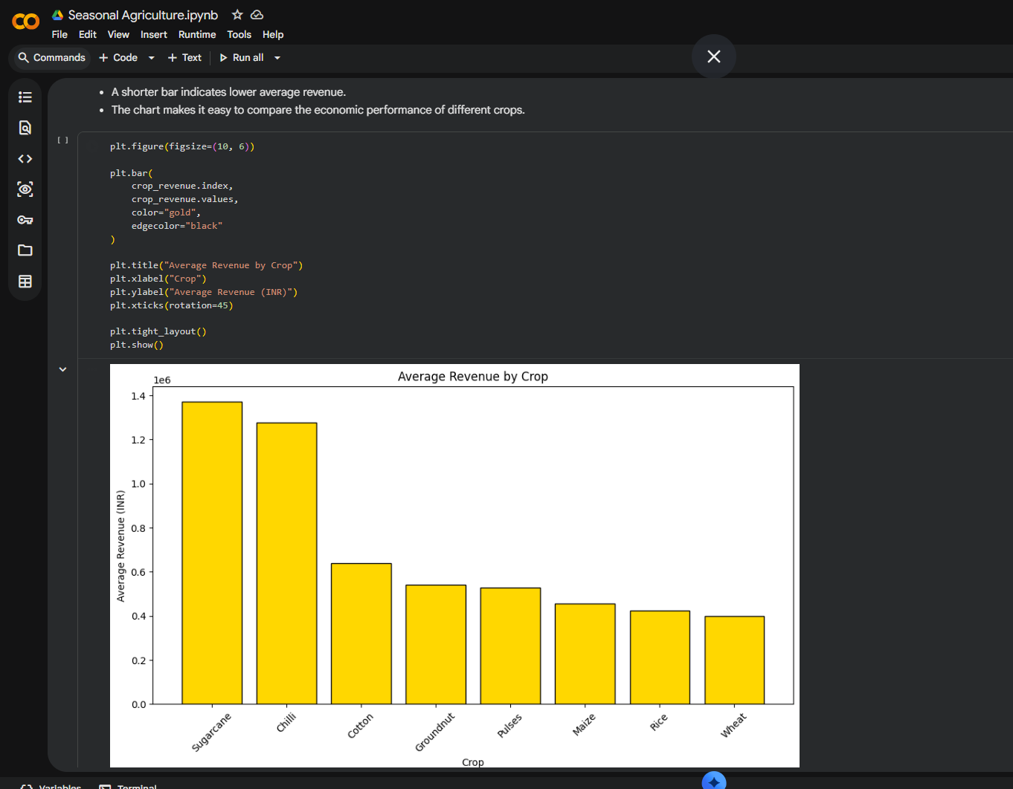
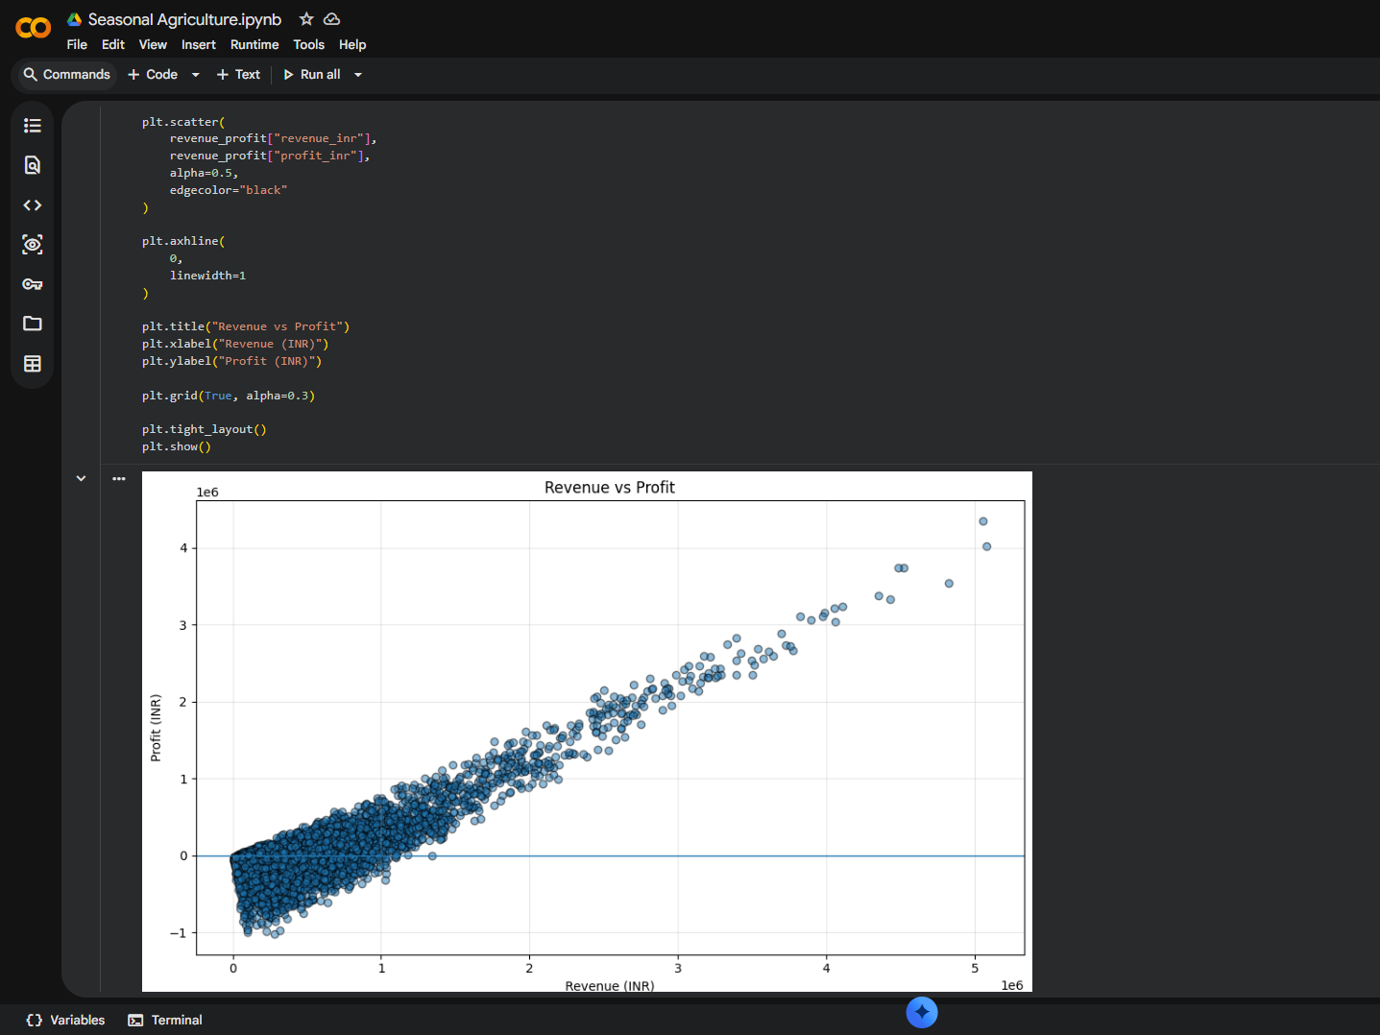
RESULTS

Slide 11
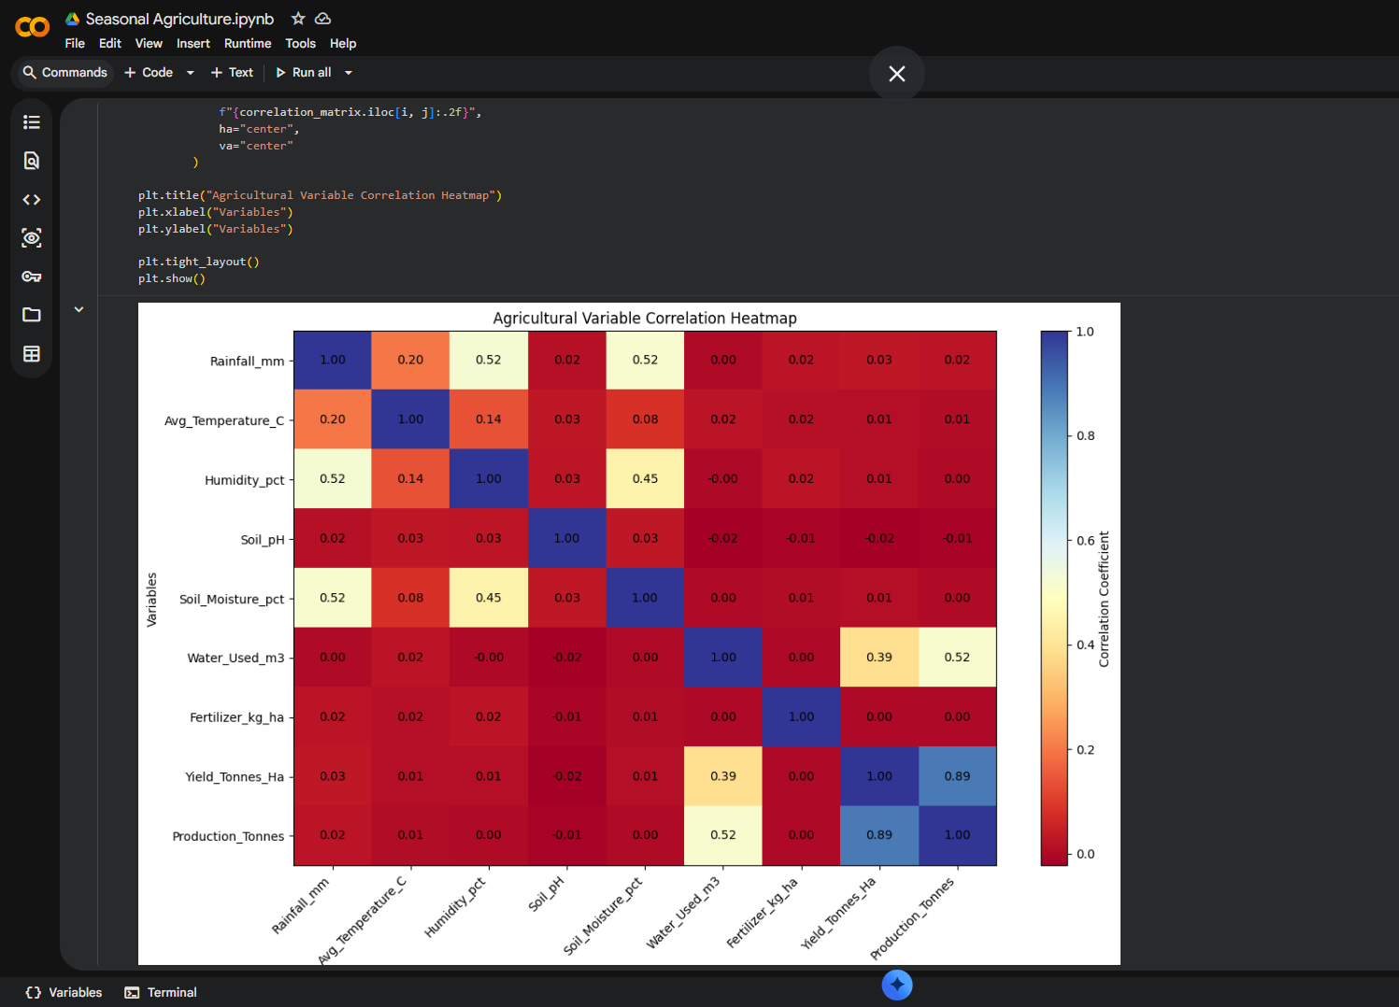
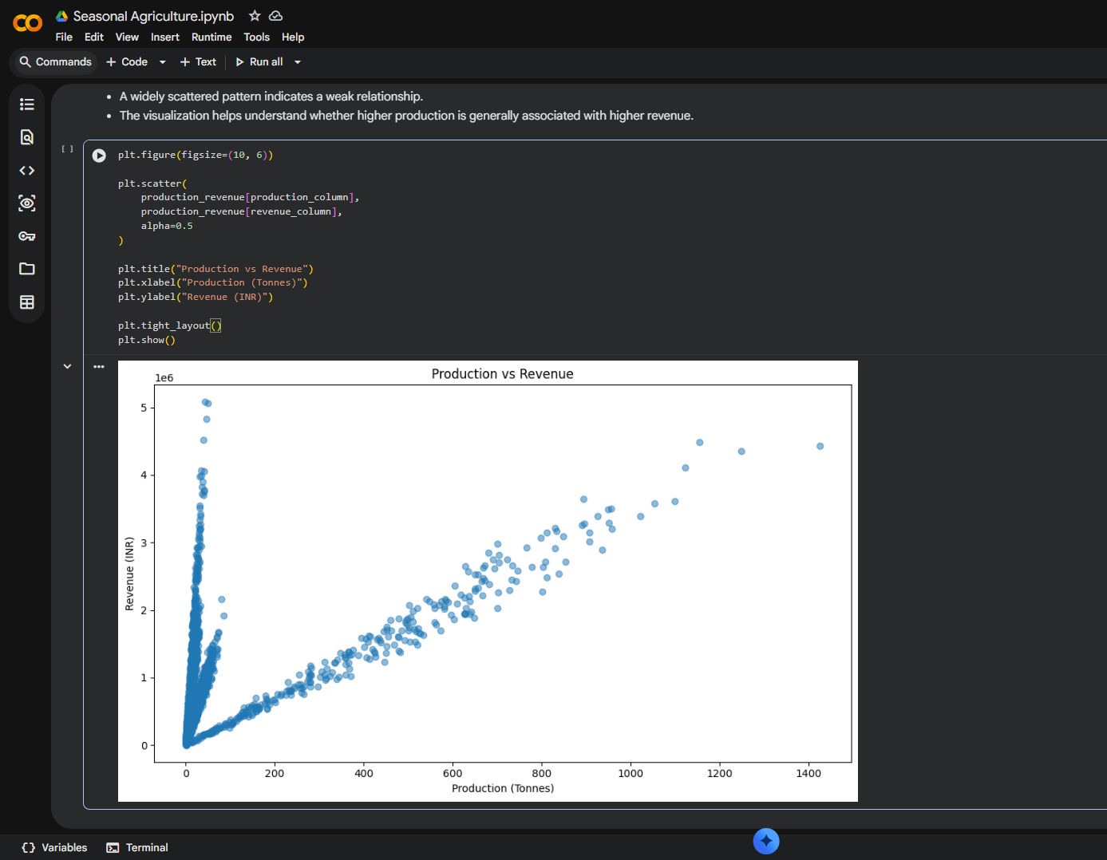
RESULTS

Slide 12
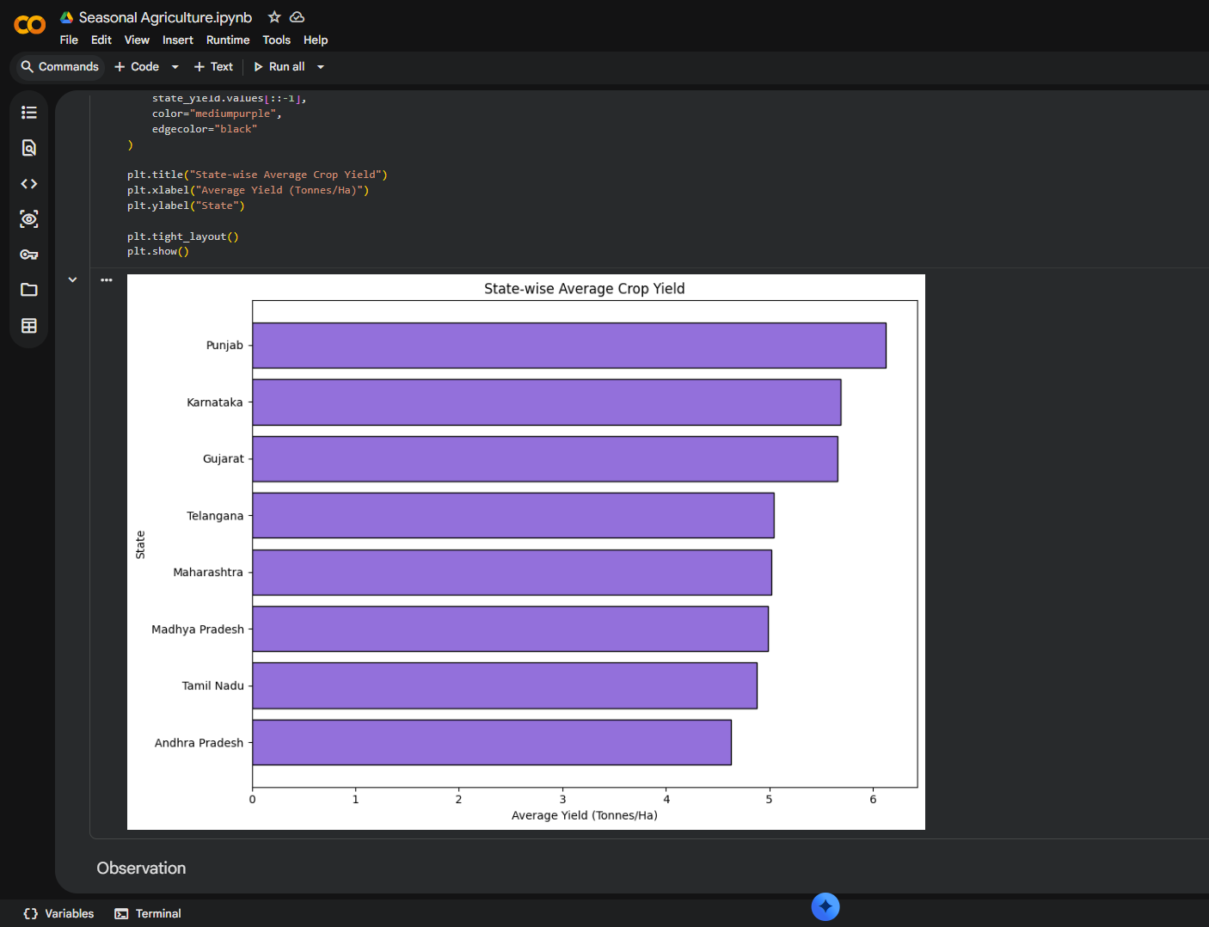
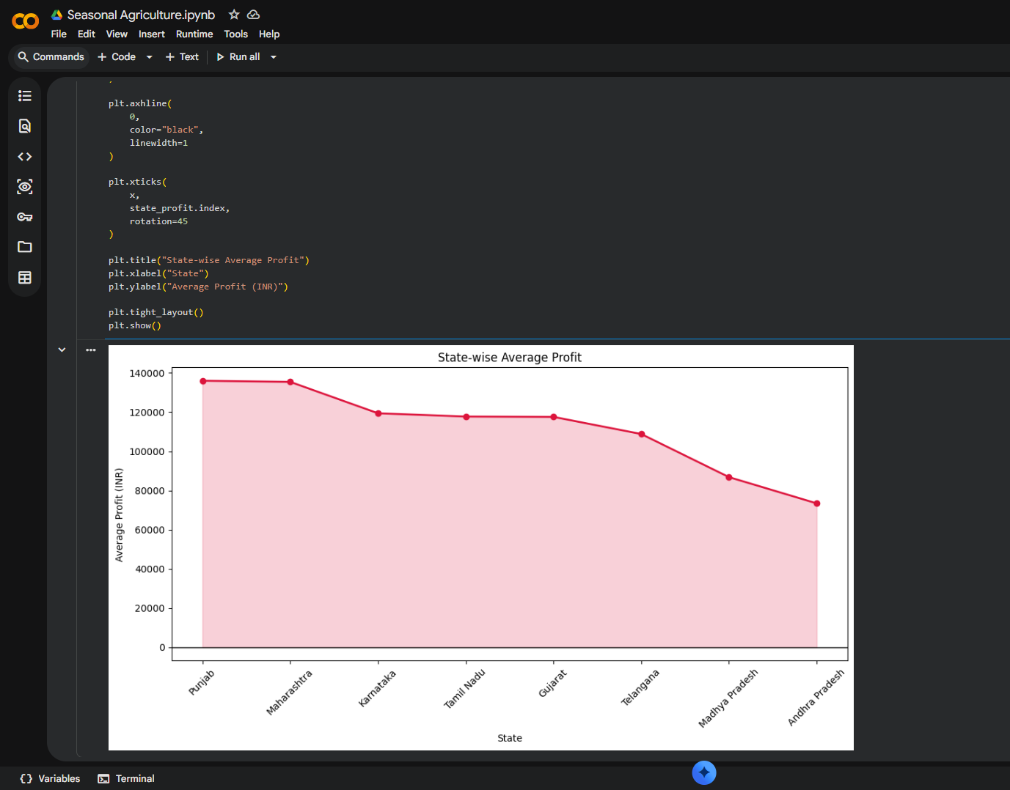
RESULTS

Slide 13
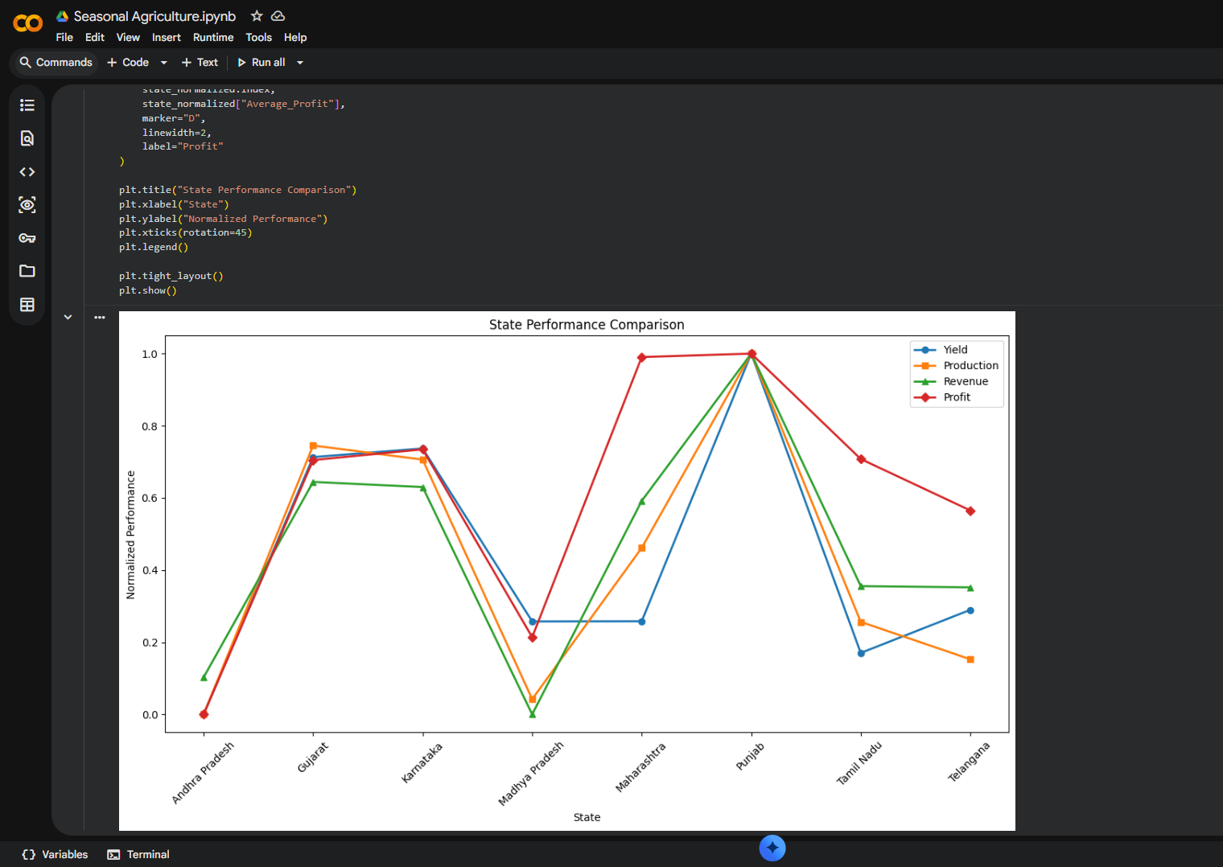
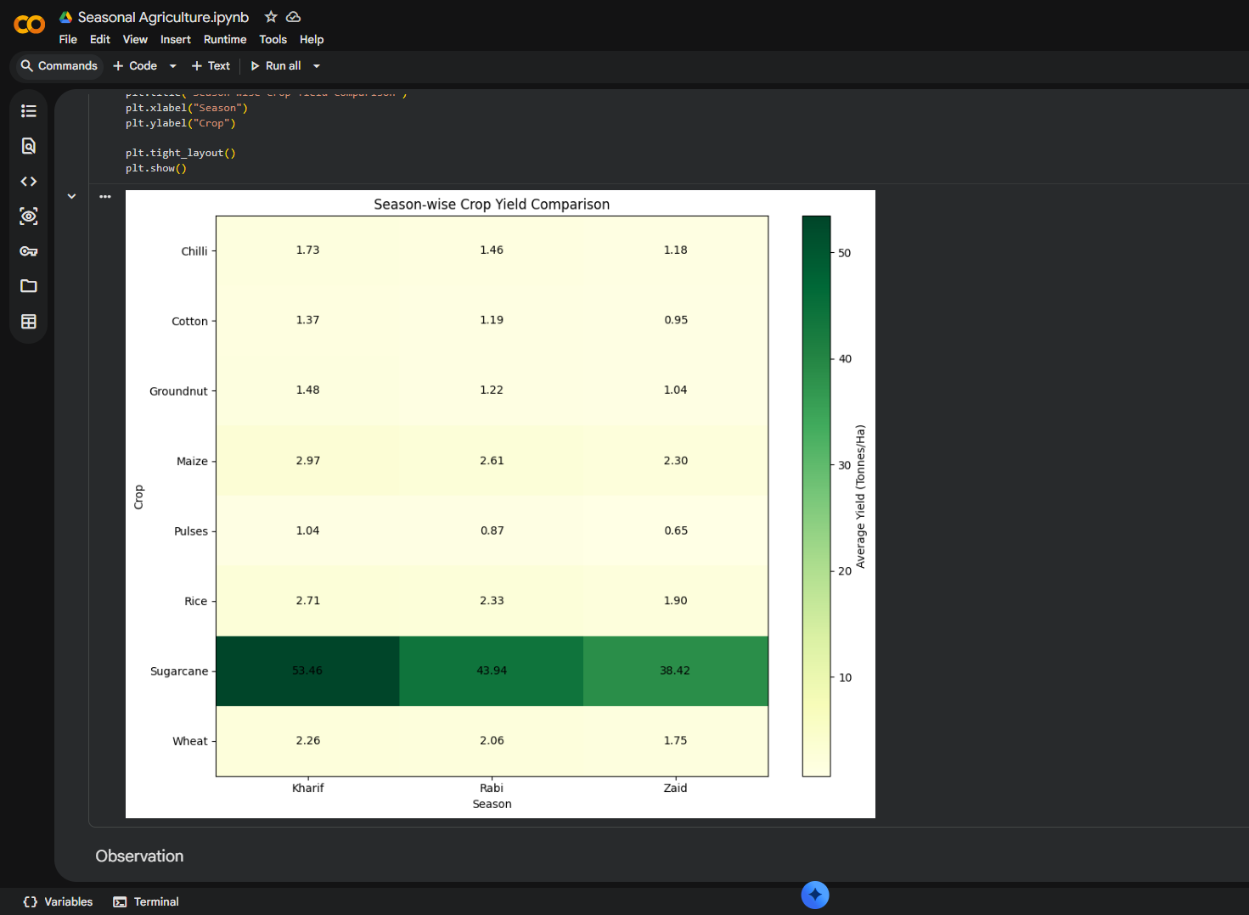
RESULTS

Slide 14
Future scope
Machine Learning: Develop models to predict crop yield and profit.
Feature Engineering: Create additional features to improve analytical insights.
Interactive Dashboard: Build dashboards for seasonal, crop, resource, economic, and geographical analysis.
Predictive Agricultural Planning: Use historical data to support future crop and seasonal planning.
Advanced Analysis: Apply more advanced statistical and predictive techniques to identify deeper patterns.
Real-Time Data Integration: Incorporate weather, market, and farming data for more dynamic analysis.
Decision Support System: Develop a data-driven system to assist farmers and agricultural planners.

Slide 15
GitHub Link
https://github.com/Shoaib05504/Seasonal-Agriculture-Performance-Analysis

Slide 16

VOIS Course completion certificate -
Course name- Data Visualization

Slide 17
THANK YOU
Seasonal Agriculture Performance Analysis
GitHub Repository
.

